Slide 1
SC1015 MINI PROJECT
A127 GROUP 8
KEEFER LOO U2222781K
BRENDAN TEO U2220079K
KENNETH YEW U2222758H
Notes:
https://github.com/albrito1/SC1015-A127-Grp-0
Hello and welcome to our group mini project presentation for SC1015. Our team members are me, myself, Keefer, Brendan and Kenneth.

Slide 2
OUR FLOW
Data Preprocessing & Manipulation
Introduction
Conclusion
02
04
01
03
05
Exploratory Data Analysis
Machine Learning
Data Cleaning
Data Manipulation
Background
Problem Statement
Outcome
Recommendation
Lasso Linear
Ridge Linear
Elastic Net
Polynomial Regression
Data Exploration
Data Preprocessing
Notes:
This will be the flow of our presentation, we will first begin with our introduction, then by our Exploratory Data Analysis and Data preprocessing and Manipulation, our machine learning component covering the different predicting techniques we used and finally our conclusion to end us all off.

Slide 3
01
Introduction

Slide 4

Background
Walmart, one of the top retailers in the US, would like to make accurate sales and demands predictions.
Due to the improper machine learning algorithm and unforeseen demands, the company is facing a challenge.
Therefore, our group’s objective is to find out which algorithm would be ideal in predicting sales and demands
Notes:
So, our focus in our project today will be Walmart Sales. Walmart has always been looking for way to make accurate sales and demands predictions. However, due to the improper machine learning algorithm and unforeseen demands, the company is facing a challenge. Therefore, our group’s objective is to find out which algorithm would be ideal in predicting sales and demands.

Slide 5

Problem Statement
zoo
How can we better predict these unforeseen demands?
What are the key features that would affect our prediction? Are there any correlation between them?
Do the predictive models have any weaknesses? If so, what are they?
Which is the ideal predictive modelling that can predict demand and sales accurately?
Notes:
So with the issues that was stated previously, these are the couple of problem statements that we have came up with. Such as, How can we better predict these unforeseen demands? What are the key features that would affect our prediction and are there any correlation between them? Would any of the predictive models have any weaknesses and if so, what are they? And finally, which is the ideal predictive modelling that can predict demand and sales accurately?

Slide 6
02
Data Analysis

Slide 7
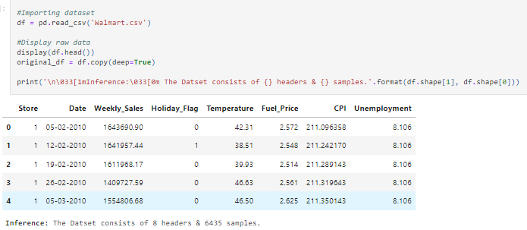
Data Exploration
Notes:
As we can see from the image, we started off with doing some simple exploration looking at no. of headers as well as samples

Slide 8
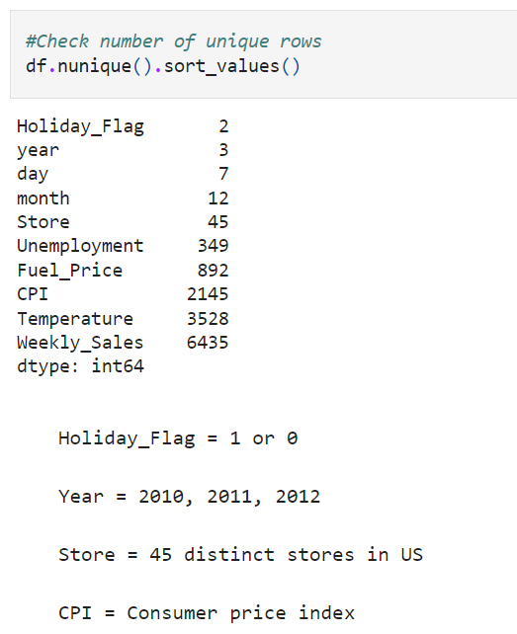
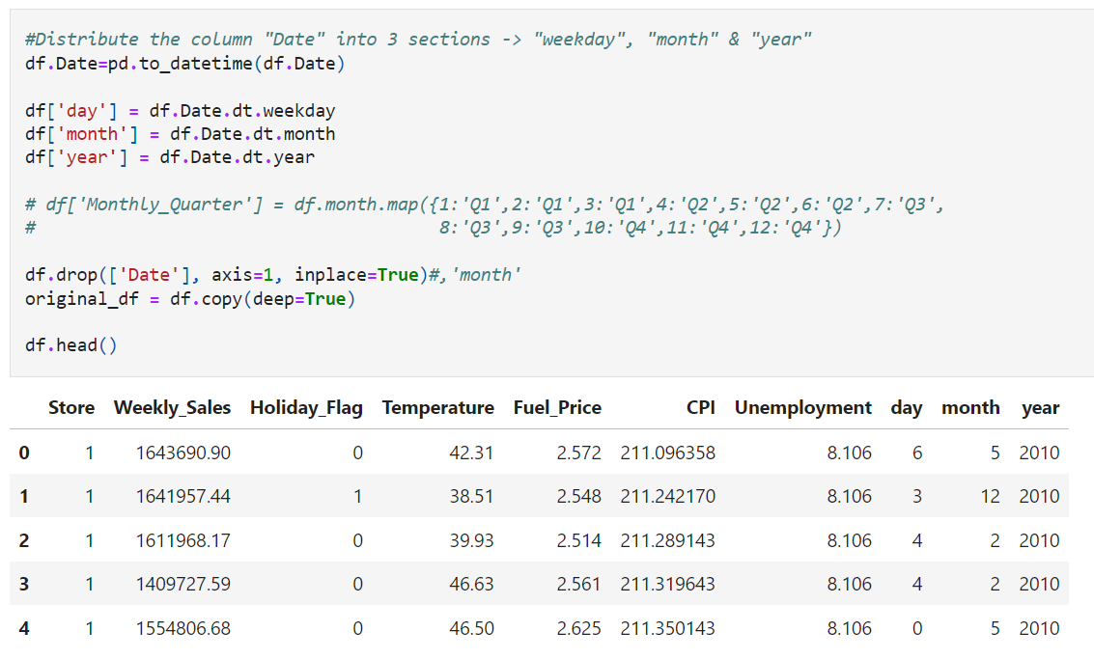
Data Exploration - cont’
Notes:
Following which, we realised that one of the features particularly “date” isn't beneficial to us in this form. Thus, we decided to splitting it up into day, month, year respectively…

Slide 9
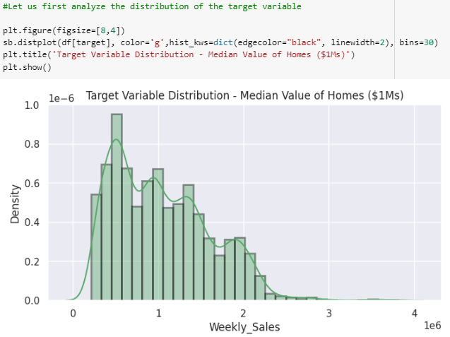
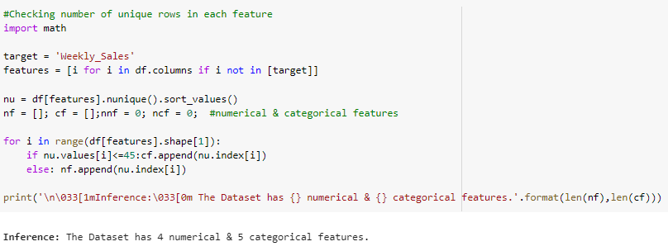
Exploratory Data Analysis
Notes:
After which, our dataset would now have a total of 4 numerical features as well as 5 categorical features. We also did a variable distribution on our target variable “Weekly Sales” as seen on the image on the right which scales to the millions, to briefly explain, the graph basically shows the distribution of weekly sales, where u can roughly tell that the 500k mark is the spike and the majority of it lies between 300k to 2mil.

Slide 10
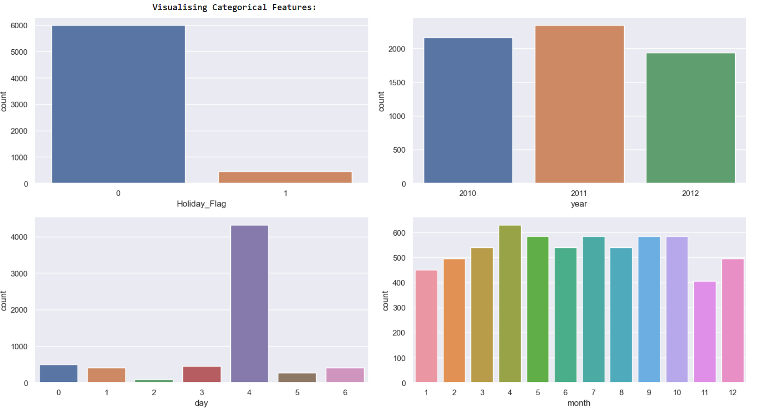
Categorial Features
Notes:
0 - Monday, 6 - Sunday
Next we move on to the Categorial Features, we can observe some significant information such as the specifically the day 4 aka friday as a major spike of sales as compared to the other days.

Slide 11
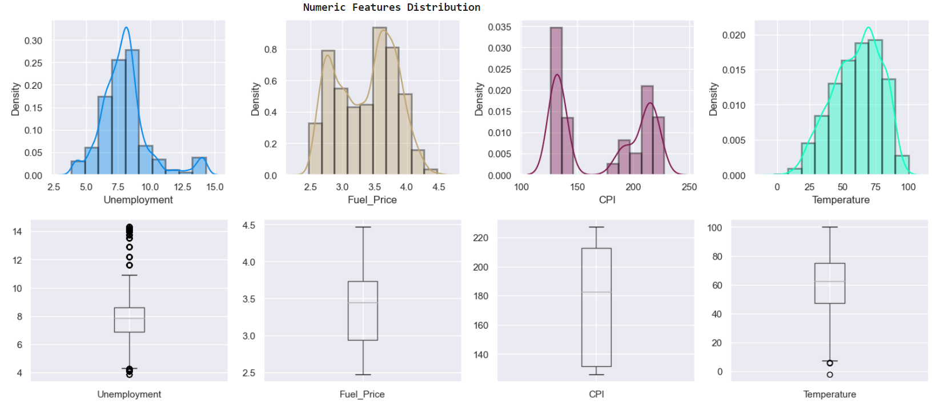
Numerical Features
Notes:
There seem to be some outliers. let us fix these in the upcoming section...

Slide 12
Data Cleaning
& Manipulation
03
Notes:
Moving on, we will talk about Data C & Data M

Slide 13
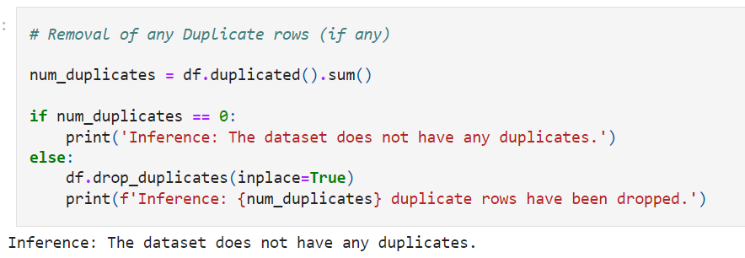
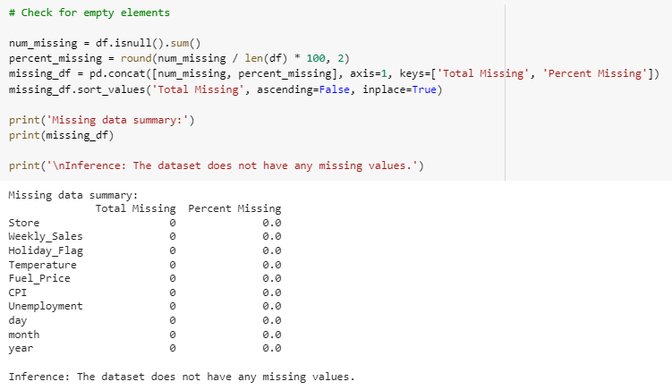
Cleaning our Dataset
Checking & Removing Duplicates
Checking for any missing values
Notes:
First up, we checked our dataset for any duplicates values, any inconsistency like NULL or empty spaces that we can remove. In our case we found nothing, so we can move on.

Slide 14
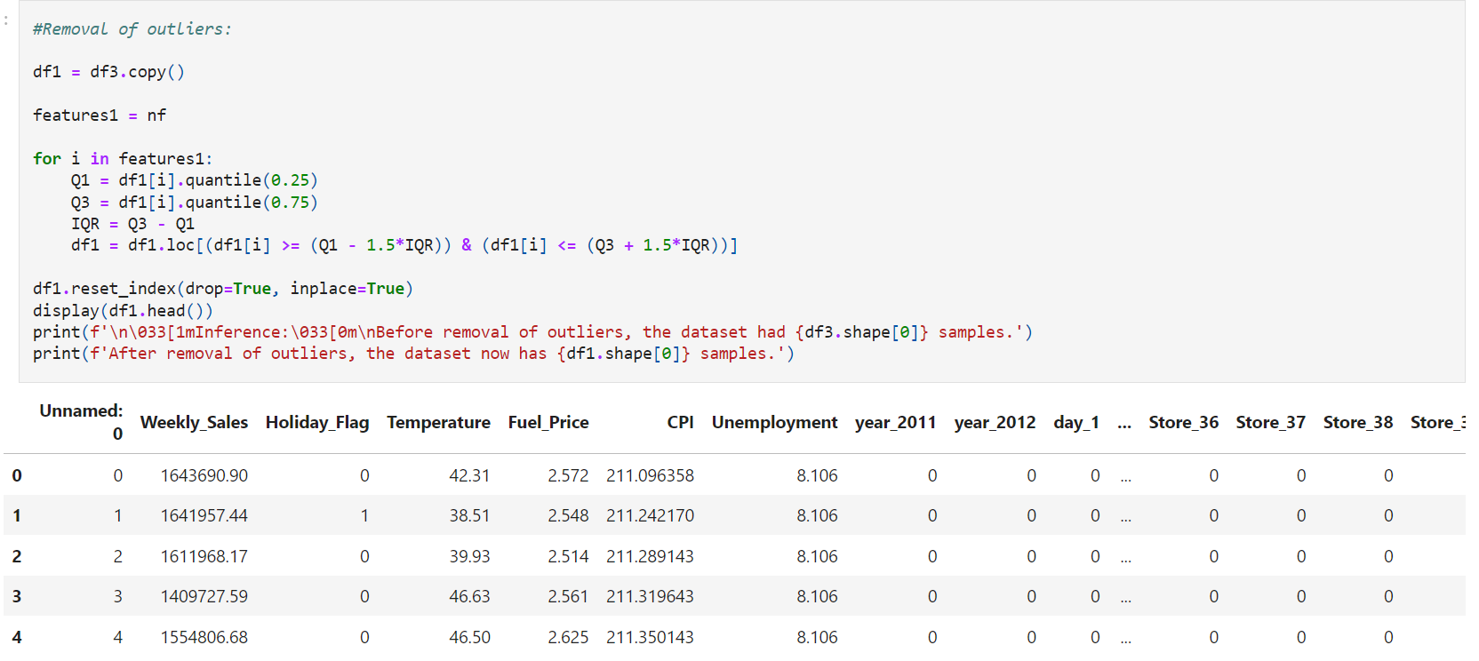
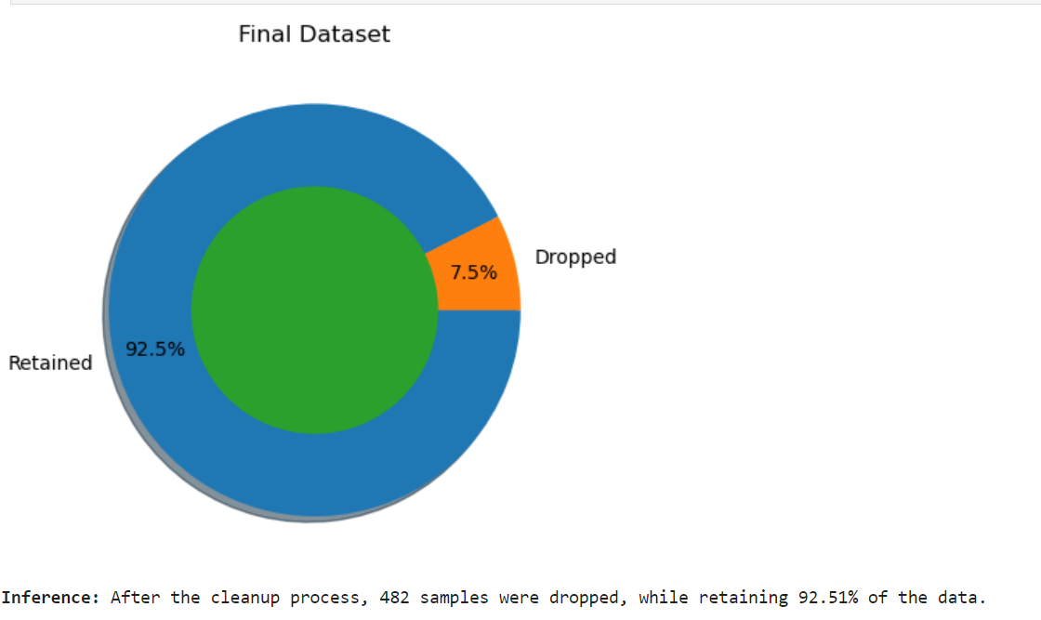
Removing Outliers
Notes:
We then proceed to remove the outliers taught to us in class, by using the interquartile range rule - we take the difference between the upper and lower quartile which helps us to identify potential outliers and remove them.
Using this technique, we removed about 7% of our 6,400 data.

Slide 15
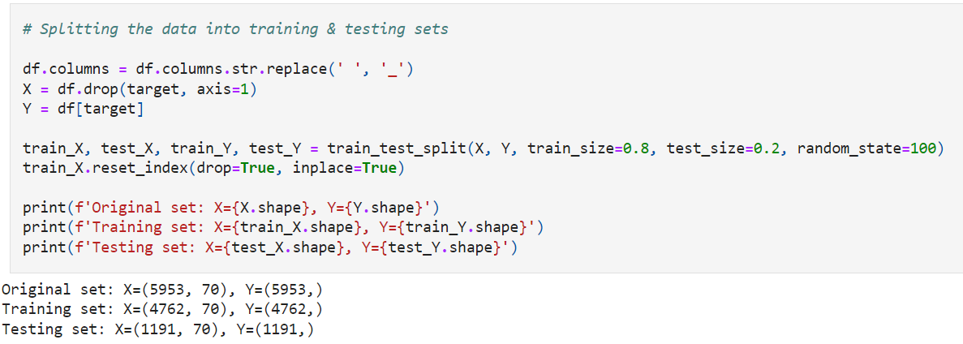
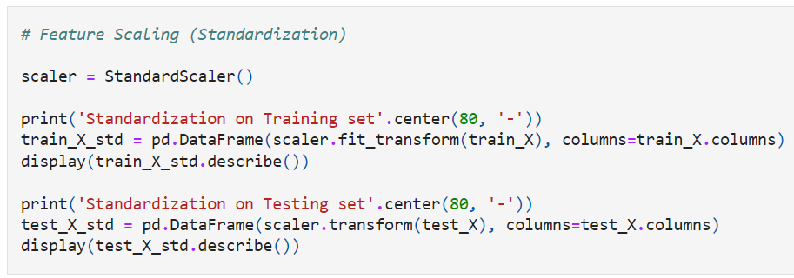
Data Manipulation
Splitting data into train and test sets
Standardization
Notes:
https://github.com/albrito1/SC1015-A127-Grp-0/blob/main/Data_Manipulation_Predictive_Modelling.ipynb
Next, we run the train test split function, using 80% as training data and the remaining 20% as test. Then we move on to implement standardization in our dataset.
We decided to use this technique to help us scale the features of our dataset, to standardize every value to have a mean of 0 and up to a standard deviation of 1. This allows our data to be more comparable, and easier to work with as they have different units and scales, which may allow some variables to dominate and skew the model prediction, causing unwanted bias in our modelling. Standardization also helps with interpretability, allowing us to create generalized graphs to aid visually for our model explanations.

Slide 16
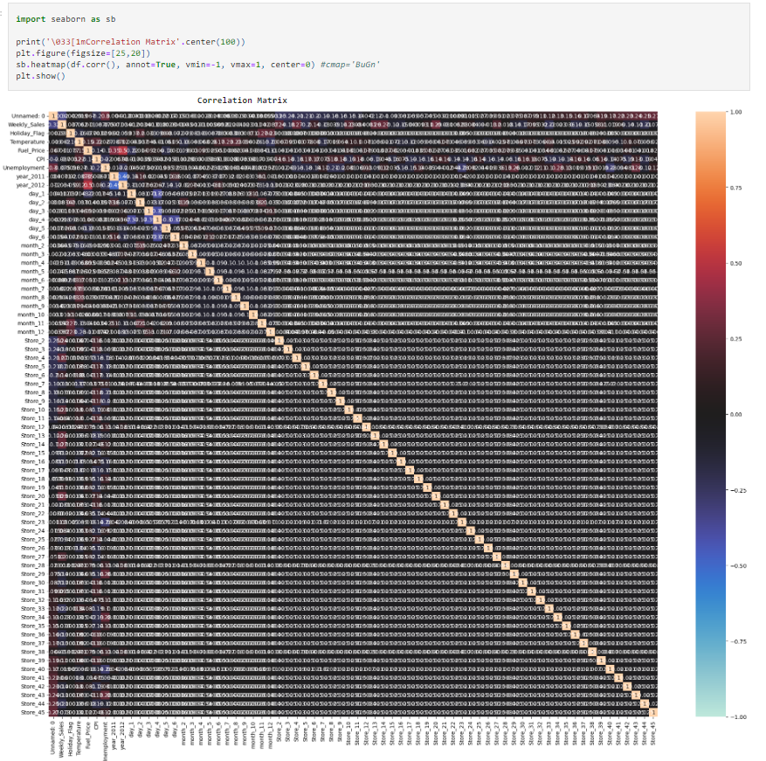
Correlation Matrix
There seems to be strong multi-correlation between the features.
Notes:
We then create a heatmap to compare correlations with every single features in this dataset. From the weekly sales row, we can see that there are multiple columns that are either blue or red, which means there is a correlation.
This show us that our weekly sales have correlations with multiple features, therefore indicating that we have a multicollinearity dataset.
Given that information, we will have to pick specific machine learning techniques to deal with this particular dataset.

Slide 17
04
Machine Learning
Notes:
We will then move on to talk about the different machine learning techniques we used in our project

Slide 18
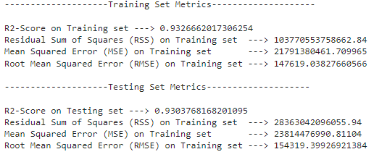
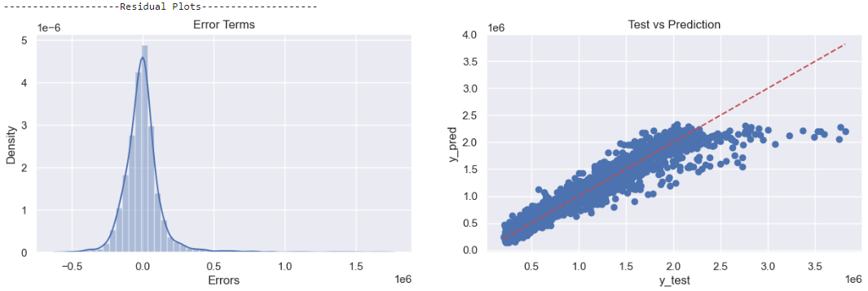
Lasso Linear Regression Model
Metrics
Graph
R² = 0.93
RSS = 10¹⁴
RMSE = 1.5x10⁵
Notes:
https://www.youtube.com/watch?v=NGf0voTMlcs
For our first regression model, we chose to use Lasso Linear Regression. This model adds a penalty term to the ordinary least squares (OLS) regression equation which helps to minimize any overfitting in the model. This encourages the model to shrink the coefficients of the less important features towards zero, and can allow removal of redundant variables entirely which makes it an effective feature selection model.
The R-squared value of 0.93 in this particular test result indicates that most of the variation in the mode is dependant. This is a fairly high number and suggests that the model is a good fit for the data.
The RMSE value also has a magnitude of 5, whereas our weekly sales have a magnitude of 6, indicating a marginal error range of roughly 10%. As such, we concluded that the Lasso Linear Regression model is a decent choice for our initial prediction.

Slide 19
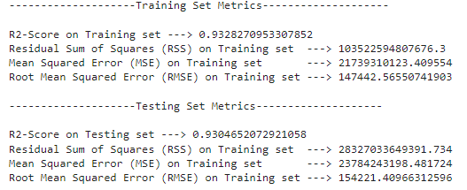
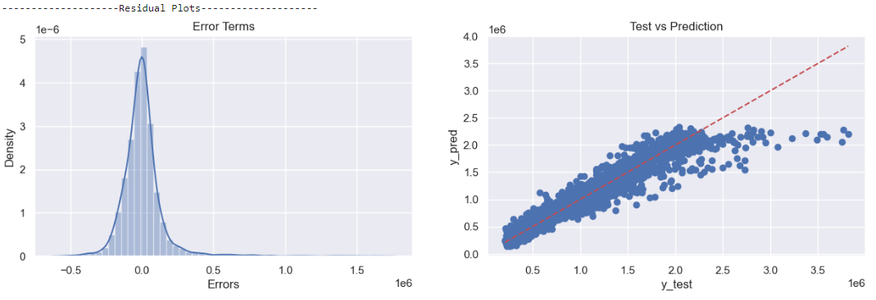
Ridge Linear Regression Model
Metrics
Graph
R² = 0.93
RSS = 10¹⁴
RMSE = 1.5x10⁵
Notes:
https://www.youtube.com/watch?v=NGf0voTMlcs
Next up, we decided to use Ridge Linear Regression as another prediction model for comparison. It is very similar to Lasso Regression as it also handle correlated features by shrinking their coefficients towards zero. However, the penalty term in ridge regression is slightly different. The constraint shrinks the coefficients of less important features towards zero, but it will never set them to zero. This reduces their impact on the model but still allowing them to contribute to the predictions.
As we can see, the values trained by the model is almost identical to the values provided by the Lasso Regression model, meaning this Ridge Regression model is also a decent option to choose

Slide 20
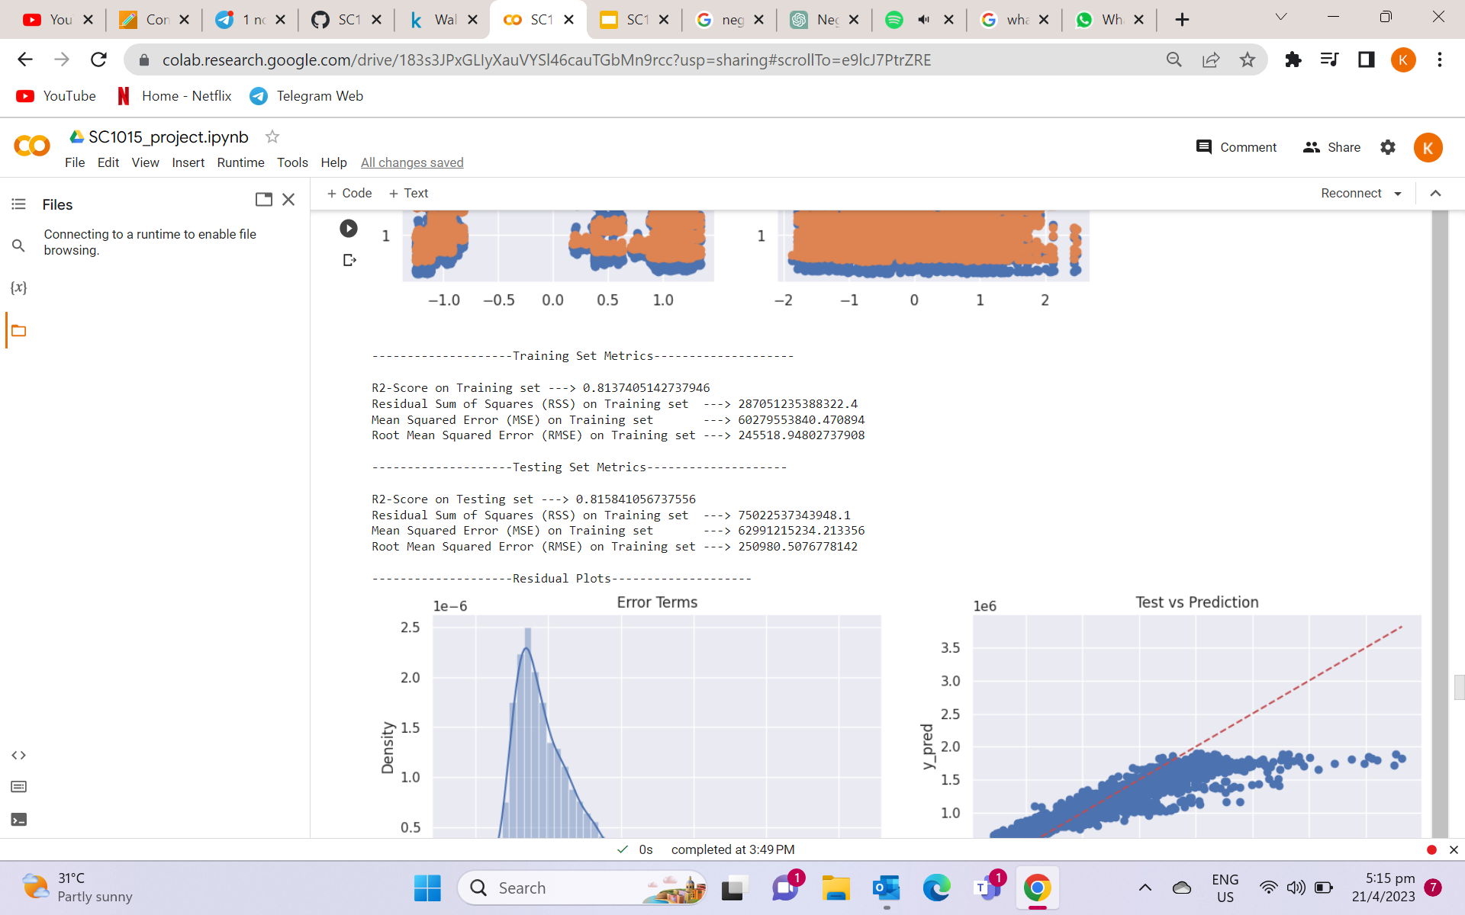
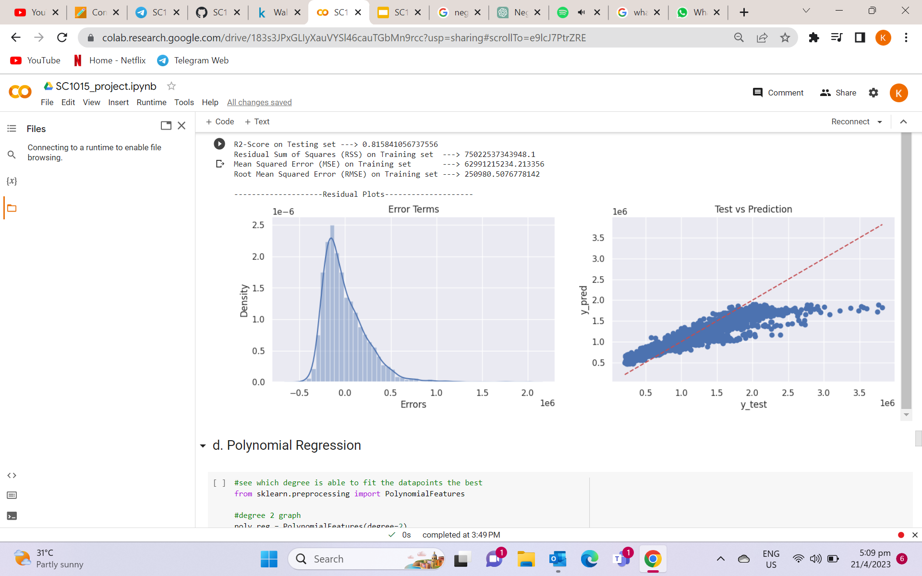
Elastic Net Regression Model
Metrics
Graph
R² = 0.81
RSS = 6x10¹⁴
RMSE = 2.5x10⁵
Notes:
Next, we tried using elastic net for our third prediction model as it is a combination technique of both Lasso and Ridge Linear Regression.
Elastic net is commonly used to overcome the limits of those two previous models. Lasso regression for example, can suffer from instability in the selection of features when there is too many correlated features in the data while Ridge regression does not set coefficients to exactly zero, which can reduce its reliability by introducing irrelevant features in its prediction.
Elastic Net tries to overcome these limits by adding a weighted combination of both the regressions’ penalty term, balancing the effect. Surprisingly, as seen in the graph, Elastic Net did not perform better than Lasso or Ridge regression. This is possibly because our dataset is decently sized and do not contain much features that needed to be shrinked. Therefore, we can rule this particular prediction model out.

Slide 21
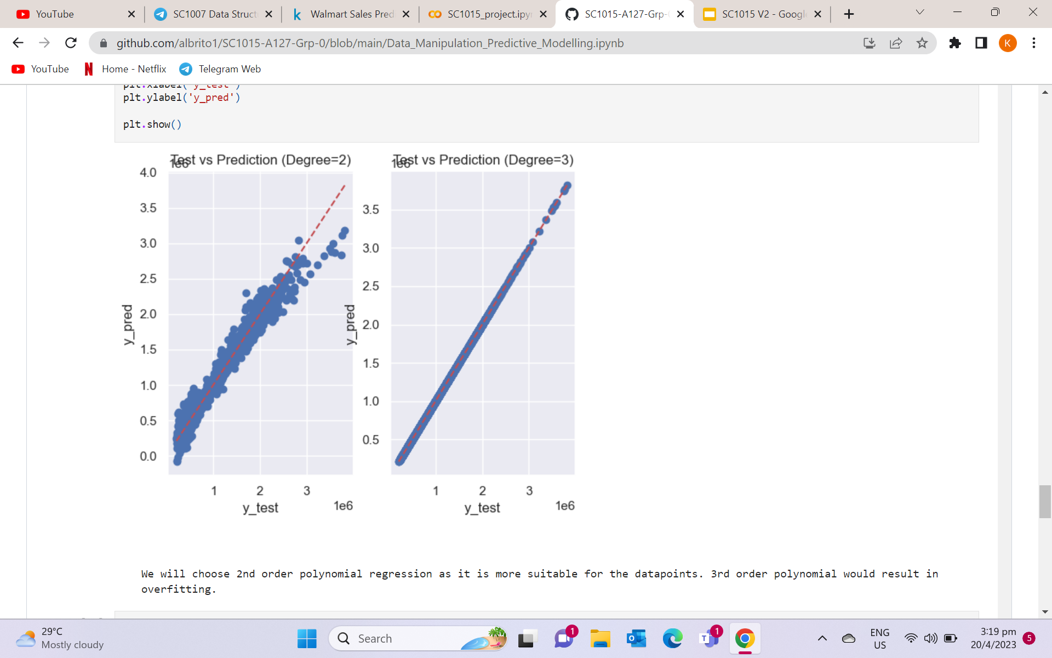
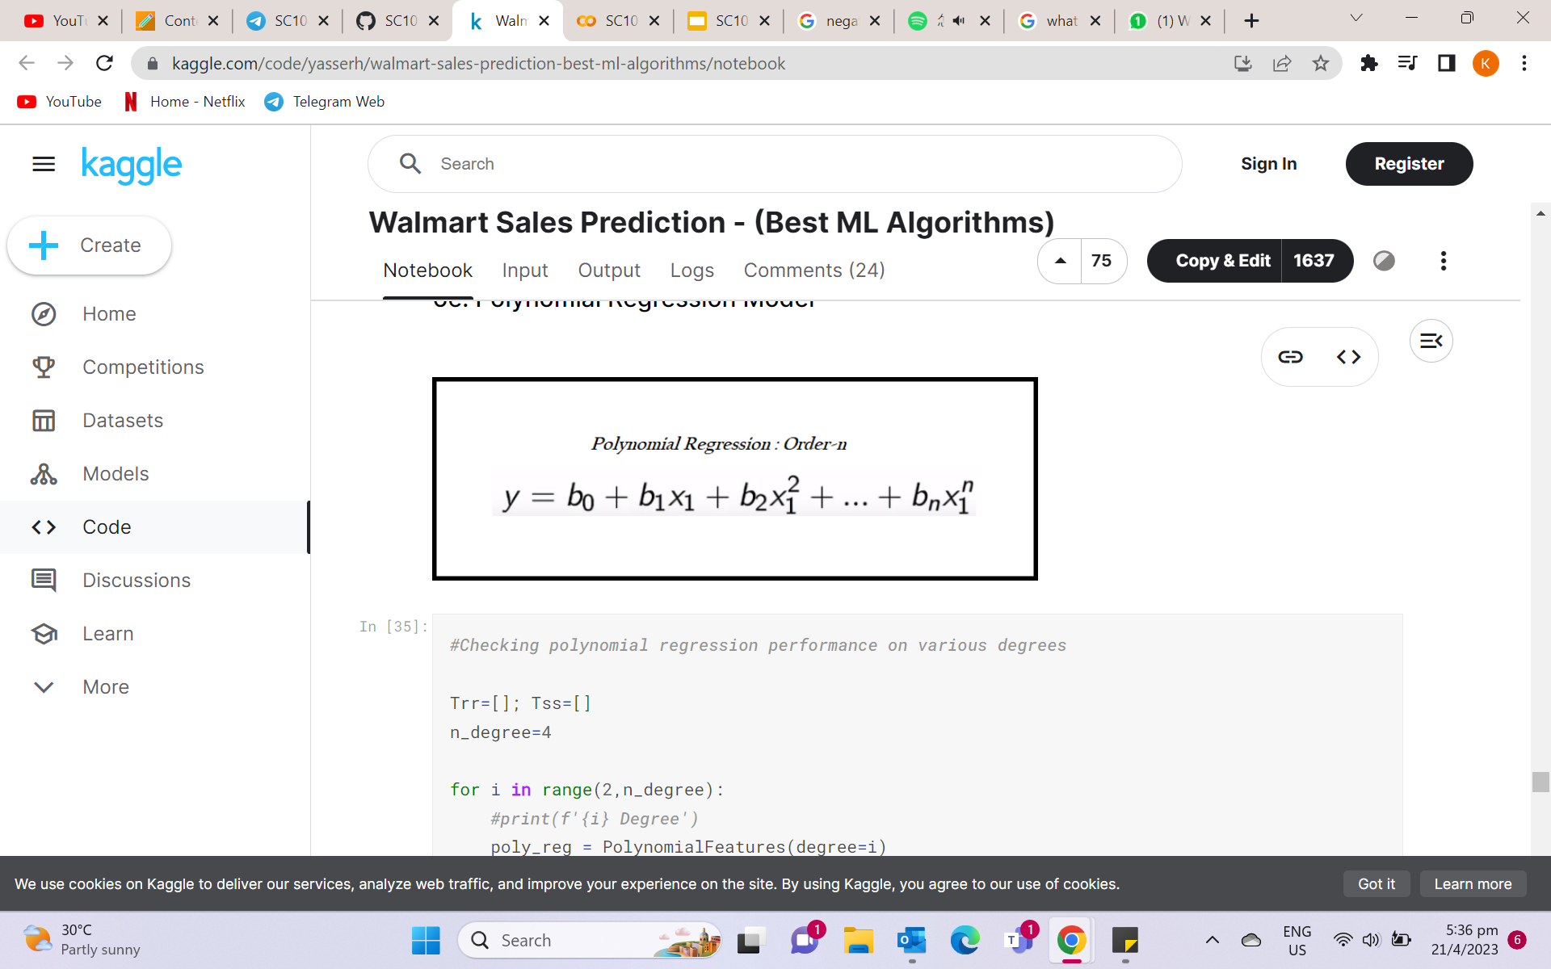

`
Notes:
Next, we will be using the polynomial regression model. CLICK It is a form of regression analysis in which the r/s b/w the independent x and the dependent variable y is modeled as an nth degree polynomial as seen in the equation given above.
For example, in simple linear regression, the r/s is modeled as a straight line, which is a first degree polynomial. However, in more complex cases whereby the r/s between x and y is not linear, a higher degree polynomial might be needed to provide a better fit to the data. Thus, we will first choose the degree of polynomial by plotting the graph of degree 2 and 3 as seen. CLICK
As we can see, degree 2 is more suitable for the data as compared to degree 3 which is a case of overfitting, whereby the model is too complex, causing it to perform very well on train data but poorly on new unseen data. CLICK

Slide 22
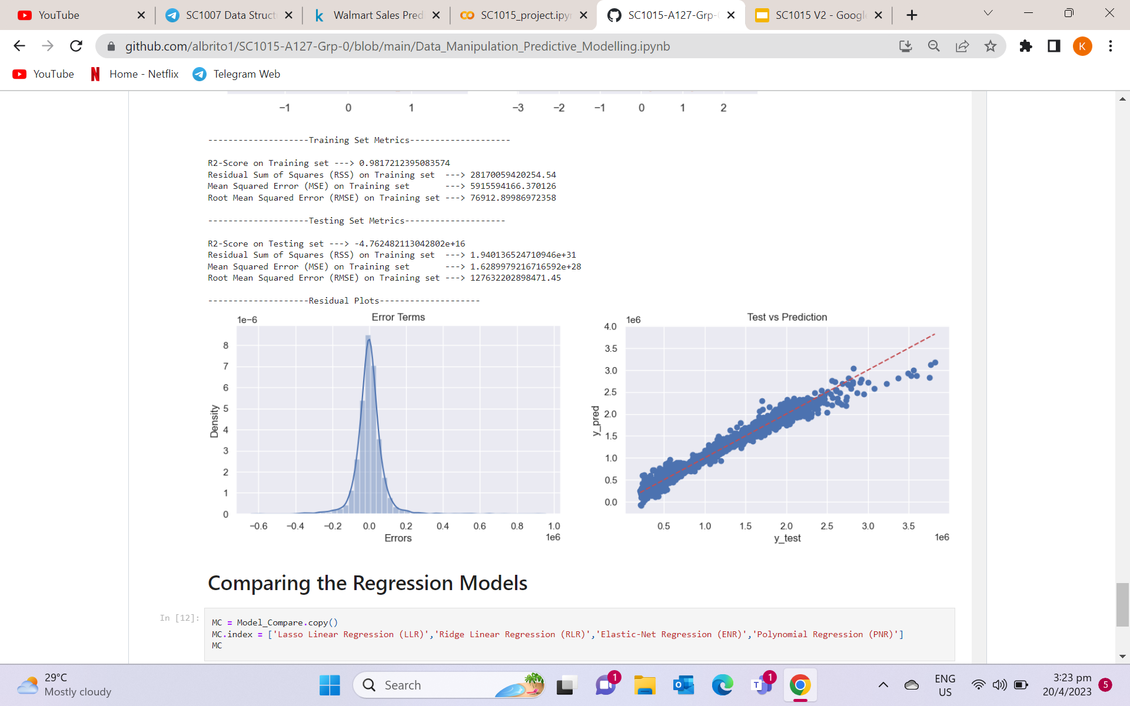
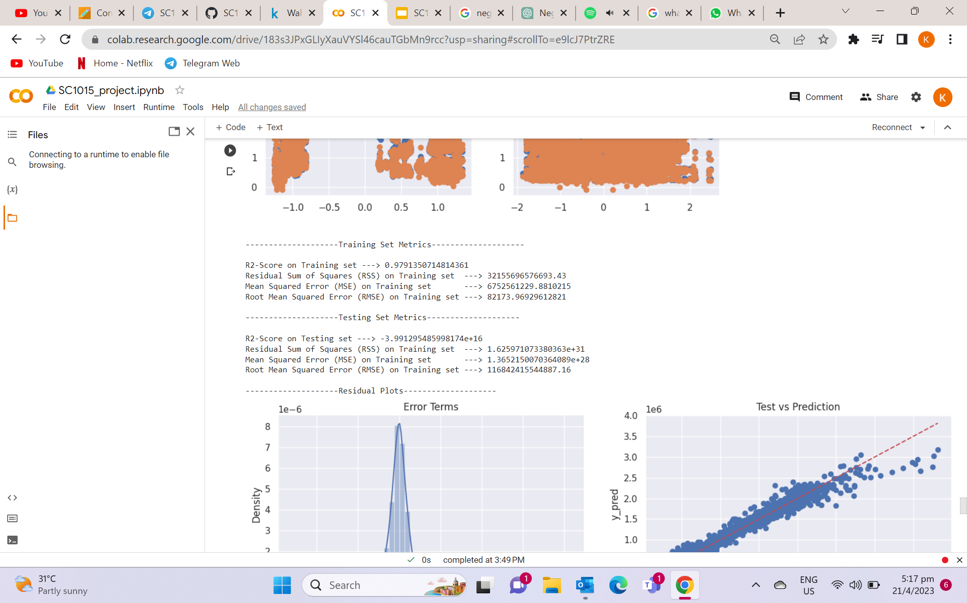
Polynomial Regression Model
R² = -3.99
RSS = 1.63
RMSE = 1.2x10¹⁴
Notes:
Next, As seen from the degree 2 polynomial model, we are able to evaluate the r square, rss and rmse. However, even with the use of degree 2 polynomial, we are still getting a negative r squared value, and an exceptionally low RSS and RMSE as compared to the other models we have used, indicating that this model is a poor fit, possibly due to overfitting as well. CLICK

Slide 23
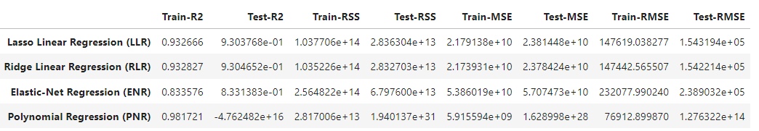
Comparison of Regression Models
Notes:
In this table, we are able to see a clear comparison between the different models that we used. CLICK CLICK
We will be focusing on the r squared and rmse values. From the r squared value, we can already eliminate polynomial as it is a clear case of overfitting with the neg r squared value while we can see that the Lasso linear and Ridge linear has the highest r squared value of 0.93. To help us better visualise the RMSE value since it seems like a lot of numbers, lets see a visual comparison of the train and test rmse of the different models. CLICK

Slide 24
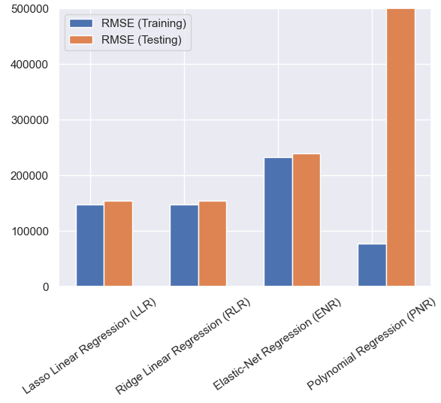
Comparison of Regression Models
Notes:
From the graph, we can tell that both lasso and ridge have very similar test and train rmse. CLICK
Since we have already eliminated the polynomial regression model due to overfitting, we can conclude that lasso and ridge has the next lowest RMSE and next highest R squared value. CLICK

Slide 25
Conclusion
05
Notes:
Now lets move on to the conclusion. CLICK

Slide 26
Outcome
Polynomial Linear Regression
Highest train R² value, low train/high test RMSE value
Case of overfitting, causes negative performance on new data
Elastic Net Regression
Moderately high train R² value , but lower than that of LLR & RLR
Moderately low RMSE value, but higher than that of LLR & RLR
Lasso Linear Regression (LLR) & Ridge Linear Regression (RLR)
High train R² value , lowest RMSE value
Notes:
These are the outcomes that we have gotten. Polynomial linear regression……

Slide 27
Recommendation
Lasso Linear Regression & Ridge Linear Regression would be the best suitable option as prediction models when it comes to multicollinearity data sets such as our Walmart data set
Notes:
Using the outcome and data driven insights that we have gotten, we have come up with a recommendation for our problem, which is to discover which machine learning algorithm would be the best to predict walmart weekly sales. And that is to use lasso linear regression and ridge linear regression as they would be the best suitable option.

Slide 28
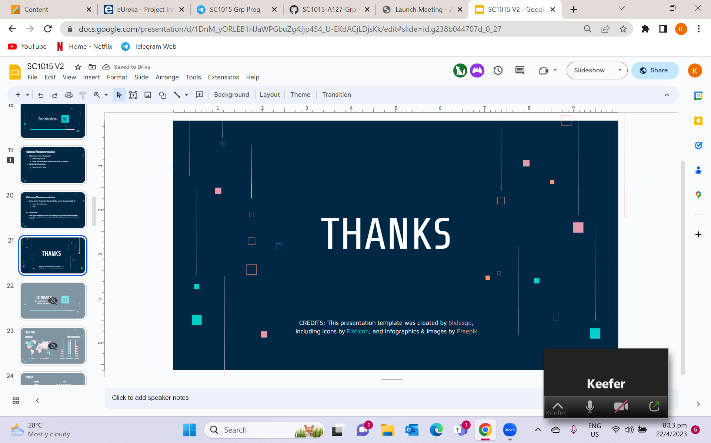
THANKS

